Slide 1
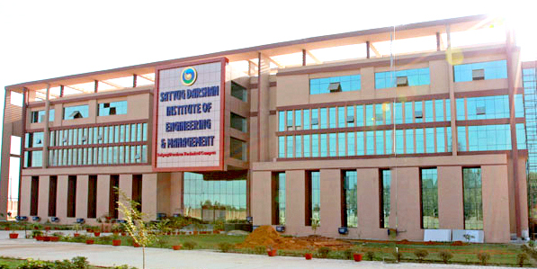
2021 - 2022
BACHELOR OF TECHNOLOGY
IN
COMPUTER SCIENCE & ENGINEERING
Submitted By :
AAYUSH JOSHI
ADITYA SHARMA
GARIMA SHARMA

Slide 2

INTRODUCTION OF PROJECT EMPLOYEE MANAGEMENT SYSTEM
This Photo by Unknown Author is licensed under CC BY-NC

Slide 3
Technology Used website development
Language Used
HTML
CSS (Cascading Style Sheets)
PHP
Javascript
MySQL (Database)

Slide 4
SOFTWARE USED
BOOTSTRAp
Vscode
WAMP SERVER

Slide 5


ADDED FEATURES
Contact information
Social media links
An Admin Block to add or remove Employee
A well formed details of Employee
Leaves/Attendance
Employee Login/Admin Login
Easy Interface

Slide 6
Web developer tools
Firefox – F12 opens the Web Console / Browser Console (since Firefox 4). ...
Google Chrome – Chrome Developer Tools (DevTools)
Internet Explorer and Microsoft Edge – F12 opens Web Developer Tools (as of version 8)
Opera – Opera Dragonfly.
Safari – Safari Web Development Tools (as of version 3)

Slide 7
main steps on how to develop aN EMPLOYEE MANAGEMENT SYSTEM:
Set the requirements and create a list of essential features.
Hire a team of experienced developers.
Deploy your website (Employee Management System)
Get users' feedback and add advanced features
Upgrade the employees on joining/leaving regularly

Slide 8

Website look like

Slide 9

Any queries ?
This Photo by Unknown Author is licensed under CC BY-NC

Slide 10



